Slide 1
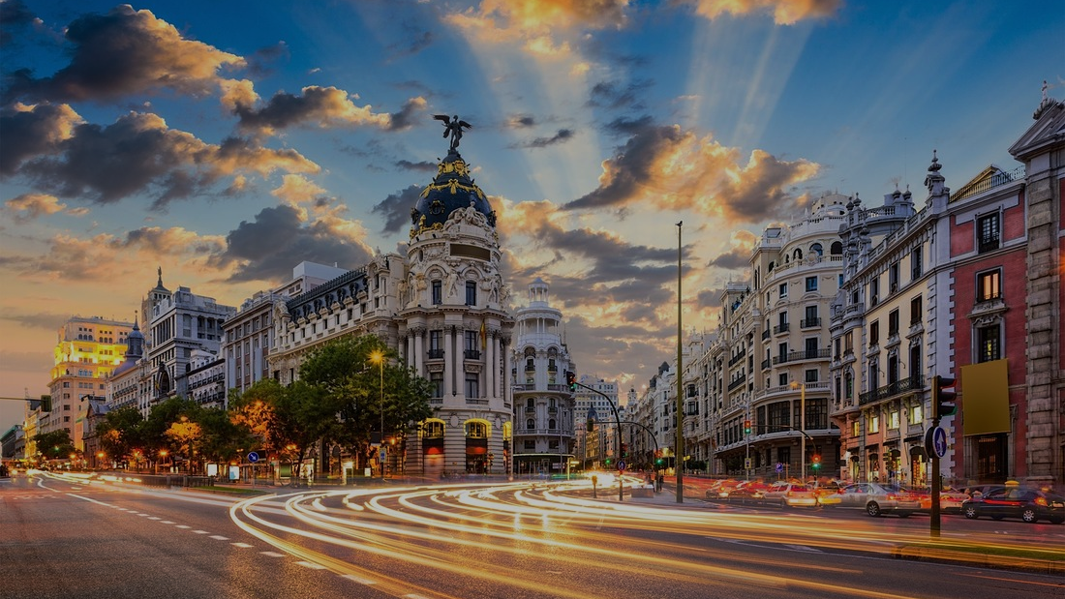
MADRID
TRADITION & MODERNITY
3 NIGHTS INCENTIVE PROGRAM

Slide 2
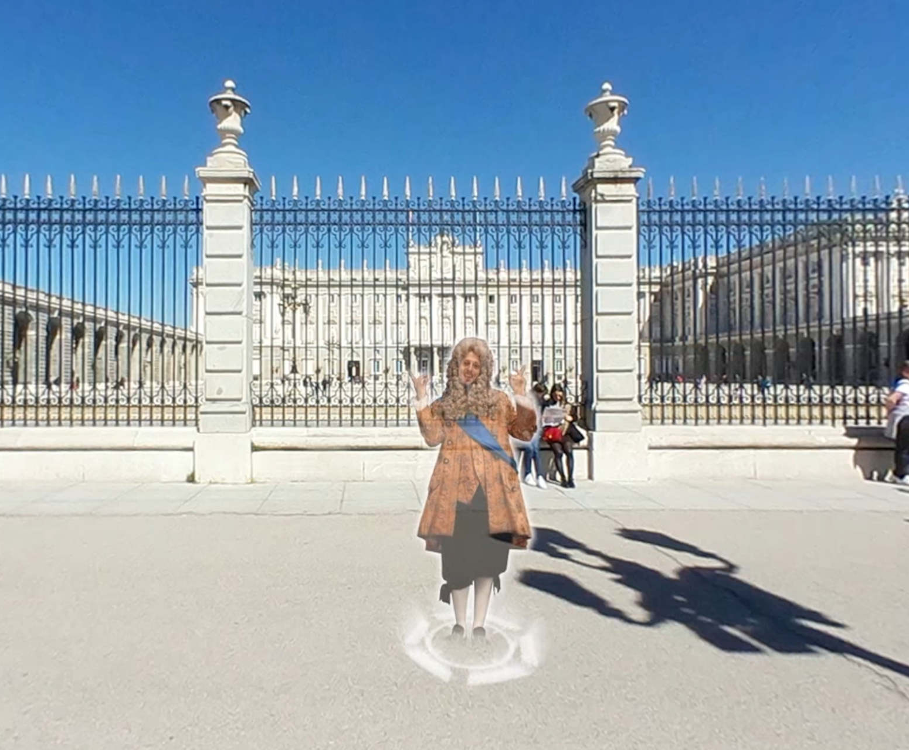
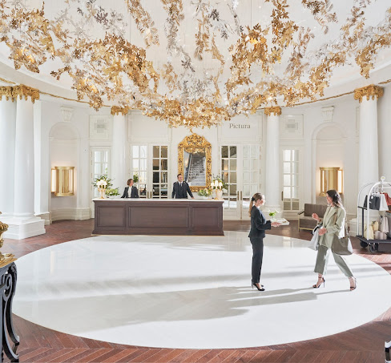

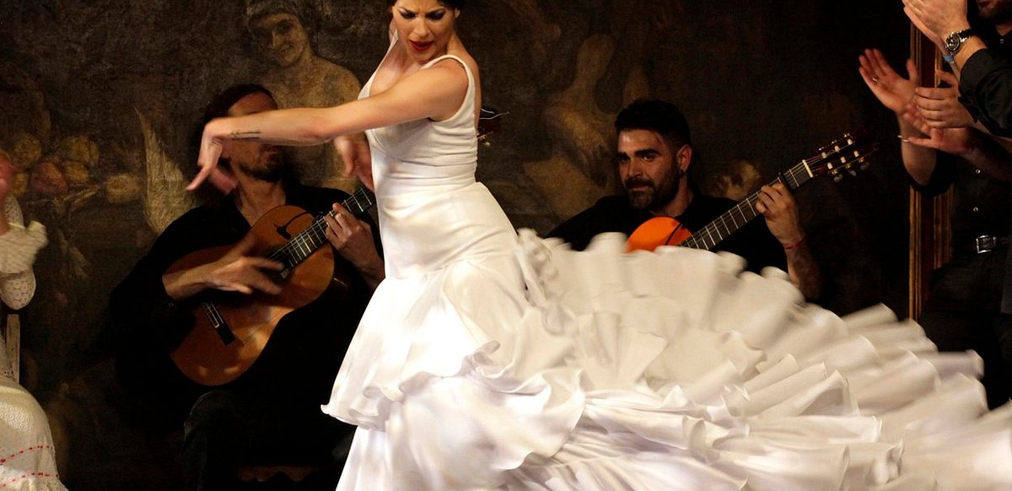
DAY 1: The essence of tradition
Arrival at Madrid airport & private transfer to a luxury hotel . Welcome drinks with panoramic city views and free time to settle in your rooms
Early evening, we will embark on an immersive tour starting at Plaza de Oriente, where we will witness Madrid’s evolution over the centuries from an aerial perspective. We will continue towards the Royal Palace, dive into the history of Plaza Mayor, and uncover the past of the iconic Puerta del Sol, the city's central hub.
First day will end with an exclusive flamenco experience at Corral de la Morería, with a Michelin-starred dinner.

Slide 3
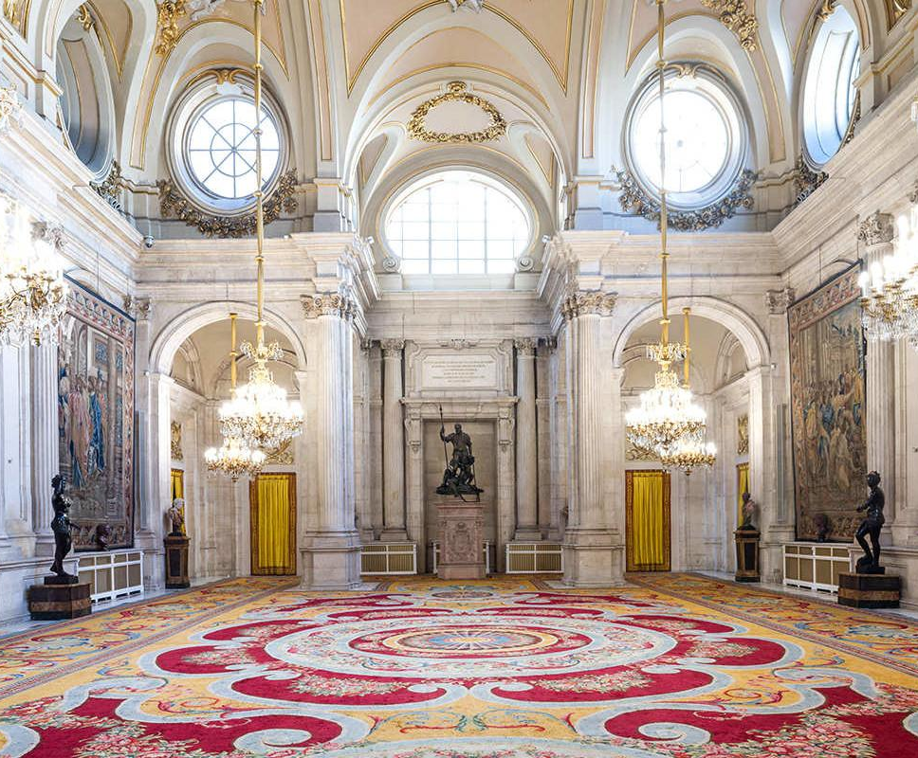
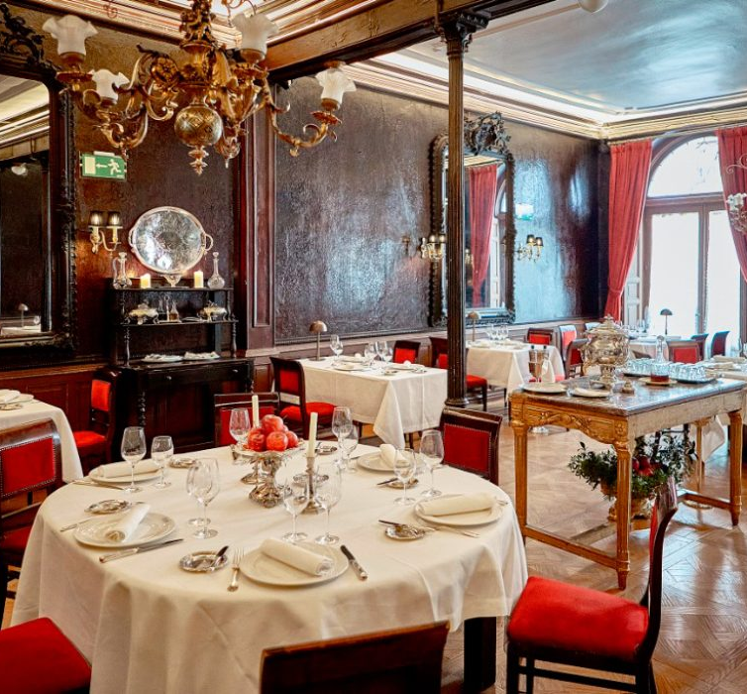
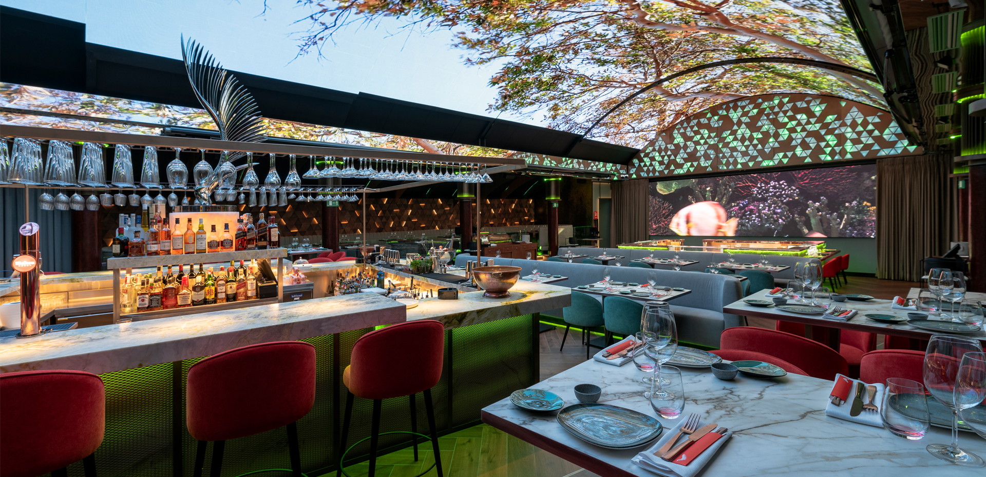
DAY 2: Icons of Madrid, past & future
Our day with start with a private guided tour of the Royal Palace & Almudena Cathedral, led by our expert guides. Next to these monuments, we will stop in a centenary "bodega" where we will taste the famous "regalito de torito" tapa
After this short break, we will continue to explore the city with a short walking tour that will lead us to one of Madrid's iconic restaurant to taste the Capital's classical dish: the cocido Madrileño.
In the evening, we will travel from past to future with a gastronomic dinner in Madrid must see restaurant featuring a rooftop with a retractable dome, where you can almost touch the stars of the capital or take a high-definition virtual tour

Slide 4
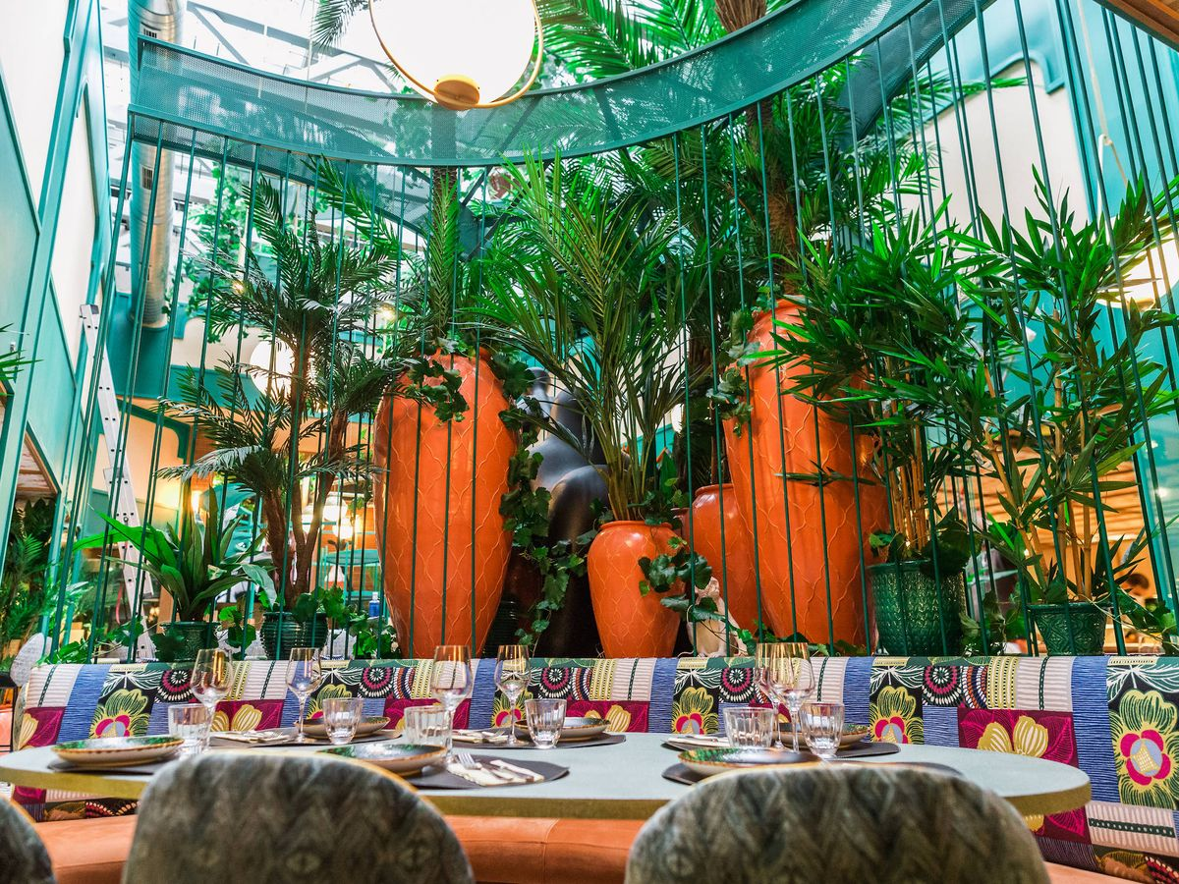
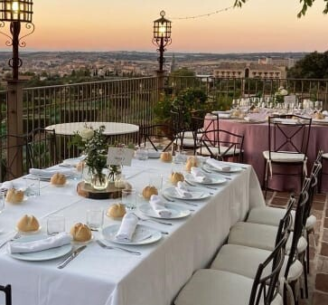
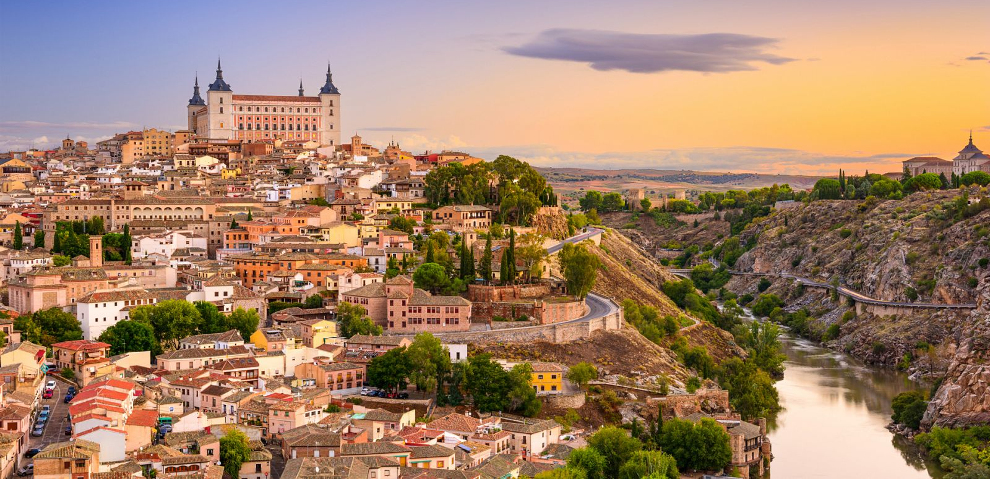
DAY 3: Toledo, the city of the
3 cultures
After breakfast, we will embark on a day excursion to Toledo, a stunning UNESCO World Heritage city where Christian, Jewish, and Muslim influences blend seamlessly. Its medieval streets, majestic Alcázar, impressive cathedral, and ancient synagogues and mosques tell a story of cultural harmony and rich history. A true open-air museum,
Our Toledo journey will continue with a visit of a Cigarral vineyard. Nestled among rolling vineyards, this exclusive setting offers the perfect blend of fine wines, exquisite local flavors (gastronomic cocktail or seated lunch options) and the serene beauty of the Tagus River valley, an unforgettable experience of tradition and elegance
Back in the city, it is time to get ready for the gala dinner! An evening of elegance and avant-garde gastronomyat one of Madrid’s most exclusive dining destinations. Throughout the evening, guests will enjoy live entertainment, from smooth jazz to an immersive DJ set, creating the perfect mood for an exclusive night. As the night unfolds, the place transforms into a vibrant social scene, inviting guests to relax, mingle, and celebrate in style

Slide 5
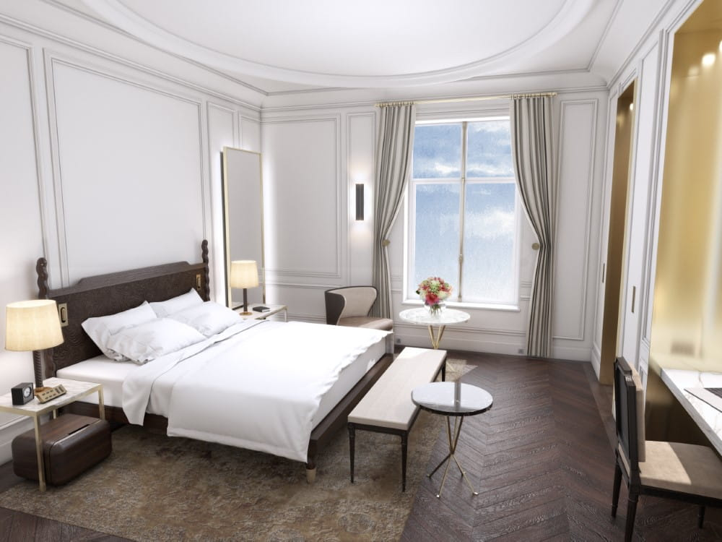
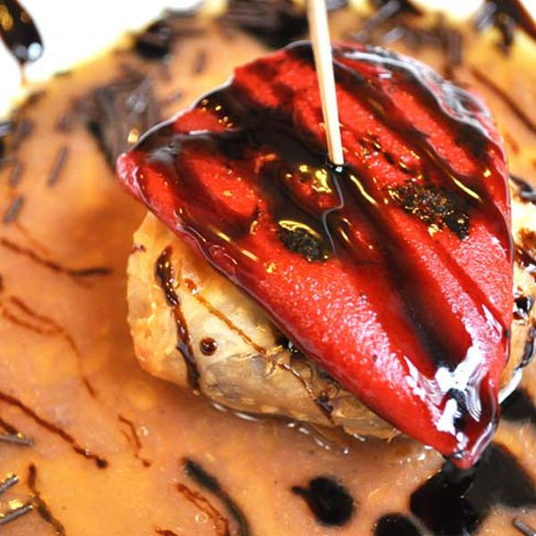
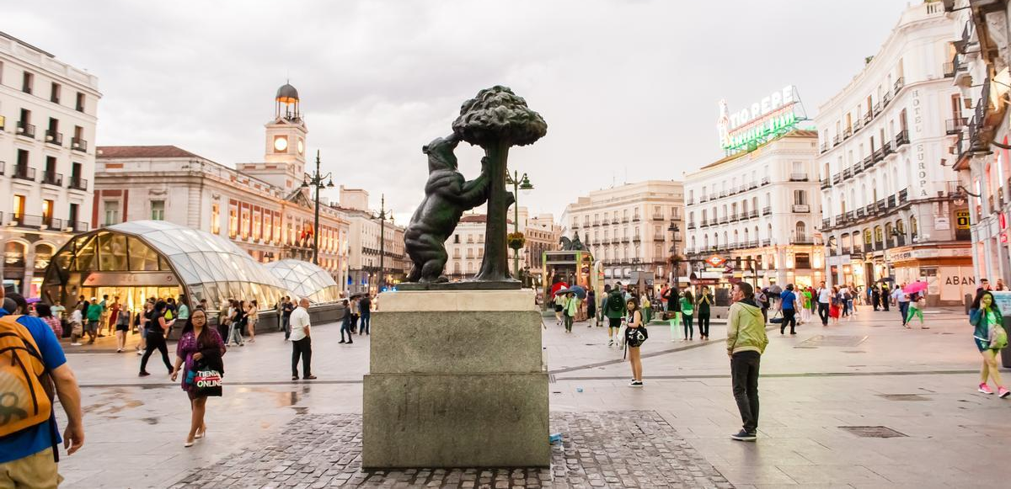
DAY 4: Hasta Pronto!
Breakfast, check out & transfer to the airport
Tell us about your project and we will discuss the best options for your event, according to your budget and special needs.

